Slide 1
Multipath TCP
Yifan Peng
Oct 11, 2012
CISC856 TCP/IP and Upper Protocol
(Much influenced by Costin Raiciu and Wei Wang)

Slide 2
Outline
Introduction and motivation
MPTCP connection
MPTCP data sequence number
Congestion control

Slide 3
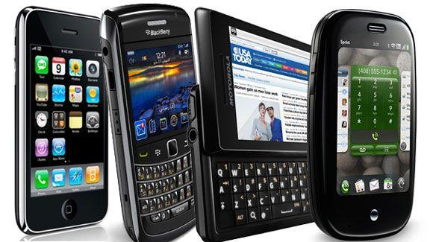
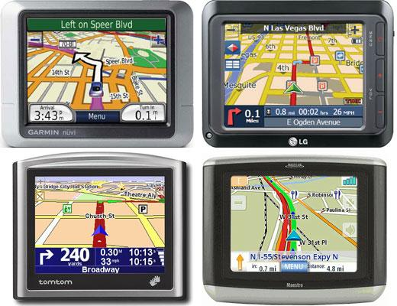
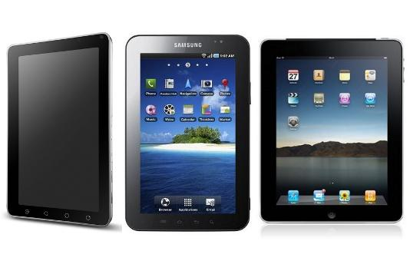
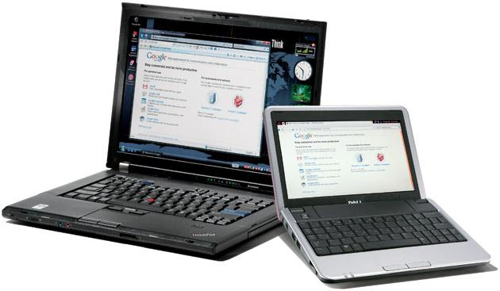
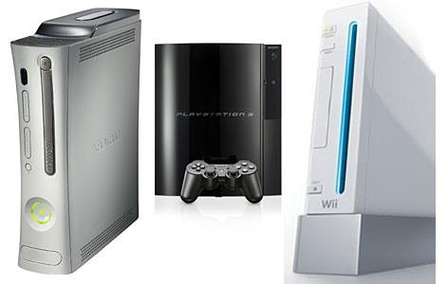
Mobile devices have multiple wireless connections
Notes:
Mobile devices have multiple wireless connections

Slide 4
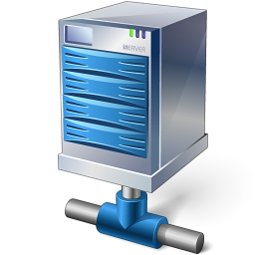
Poor performance for cellphones
3G Celltower
UDel Wifi
CIS Wifi

Slide 5
Poor performance for cellphones
3G Celltower
UDel Wifi
CIS Wifi

Slide 6
Poor performance for cellphones
3G Celltower
UDel Wifi
CIS Wifi

Slide 7
Poor performance for cellphones
3G Celltower
UDel Wifi
CIS Wifi

Slide 8
Good performance for cellphones
3G Celltower
UDel Wifi
CIS Wifi

Slide 9
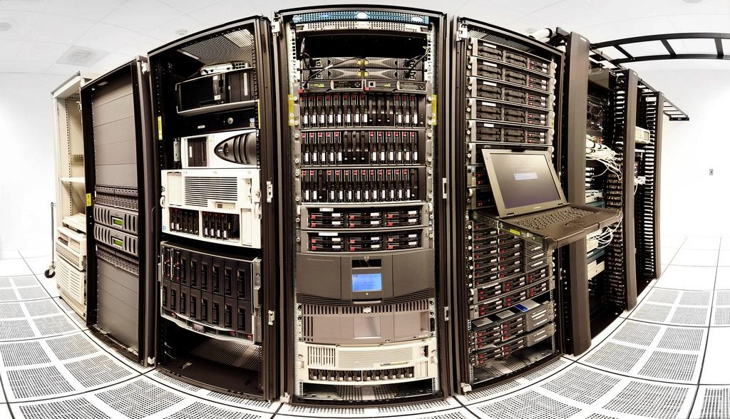
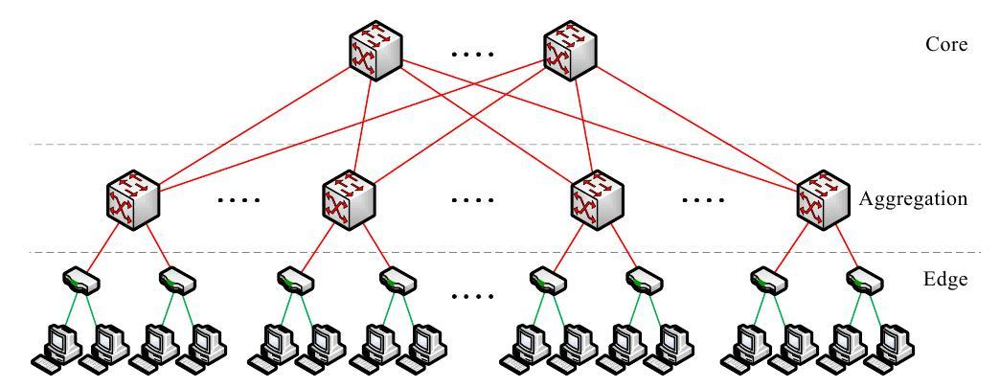
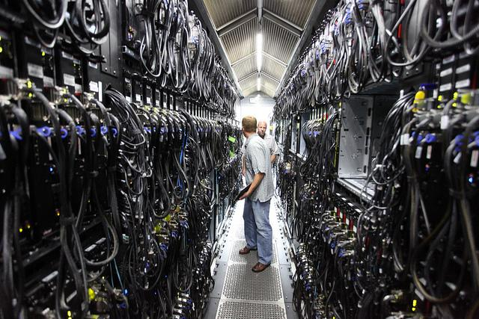
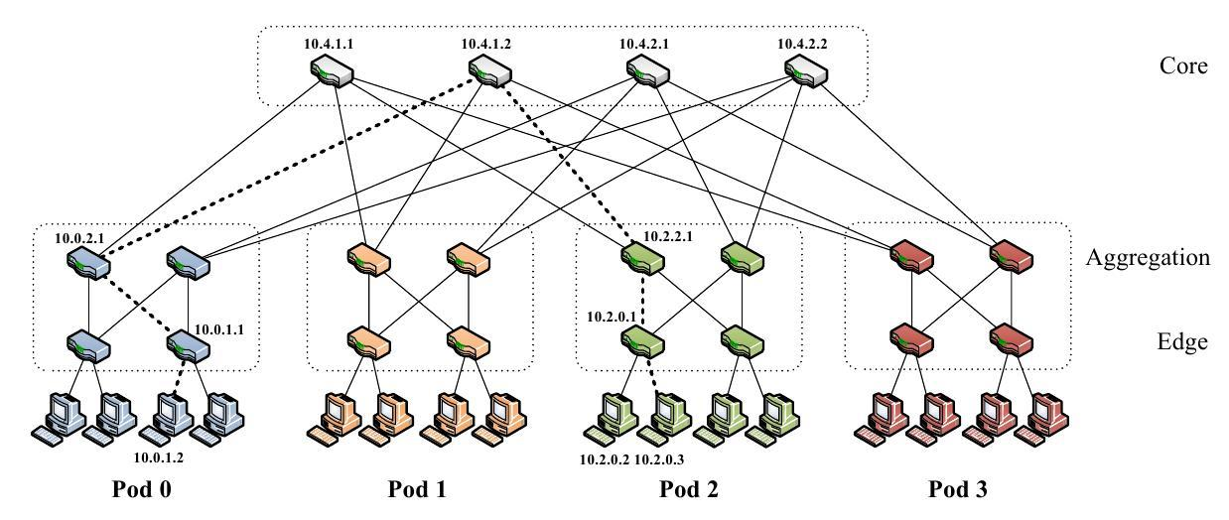
Servers are multi-homed
Notes:
Al-Fares et al. A Scalable, Commodity Data Center Network Architecture

Slide 10
Collisions in datacenter

Slide 11
Collisions in datacenter
Collisions

Slide 12
Collisions in datacenter

Slide 13
Mismatch between network and transport
Networks are becoming multipath
TCP is single path
Uses a single-path in the network regardless of network topology
Is tied to the source and destination addresses of the endpoints
Mismatch between network and transport

Slide 14
Multipath TCP
Multipath reliable data transfer is needed
Multipath TCP (MPTCP) is an evolution of TCP that provides an ability to simultaneously use multiple TCP paths between peers

Slide 15
Multipath TCP protocol stack
Application
TCP
IP
Application
MPTCP
Subflow (TCP) | Subflow (TCP)
IP
Notes:
mptcp connection, subflow path

Slide 16
Terminology
Path: a sequence of links between a sender and a receiver
Subflow: a flow of TCP segments operating over an individual path, which forms part of a larger MPTCP connection
MPTCP connection: a set of one or more subflows, over which an application can communicate between two hosts
Token: MPTCP connection ID

Slide 17
Outline
Introduction and motivation
MPTCP connection
create a MPTCP connection
add a subflow to existing MPTCP connection
close a MPTCP connection
MPTCP data sequence number
Congestion control

Slide 18
MPTCP connection
A
B
Address A1
Address A2
Address B1
SYN+MP_CAPABLE (Key-A)
SYN/ACK+MP_CAPABLE (Key-B)
ACK+MP_CAPABLE (Key-A,Key-B)
SYN+MP_JOIN (Token-B, R-A)
MAC-B = SHA-1 (
Key-B + Key-A,
R-B + R-A)
SYN/ACK+MP_JOIN (MAC-B, R-B)
MAC-A = SHA-1 (
Key-A + Key-B,
R-A + R-B)
SYN/ACK+MP_JOIN (MAC-A)
ACK

Slide 19
Closing a subflow connection
DATA FIN
used to signal to the other end that all the data has been transmitted. Once received, the endpoint knows to close all its subﬂows.
Why use the DATA FIN option?
Notes:
bi-direction

Slide 20
Closing a subflow connection
Two cases of TCP-FIN:
FINs are subﬂow speciﬁc, which means that the connection will be closed by a timeout, ﬁnishing with an error.
FINs sent on any subﬂow mean connection FIN. This means subﬂows cannot be torn-down except with the whole connection

Slide 21
Outline
Introduction and motivation
MPTCP connection
MPTCP data sequence number
Congestion control

Slide 22
Sequence numbers
Options
One sequence space shared across all paths?
One sequence space per path, plus an extra one to put data back in the correct order at the receiver?

Slide 23
Single sequence space is not
enough
1400
1401
1402
1403
1404
1400
1401
1403
1404
Host A
Host B
Address A1
Address A2
Address B1
SEQ: 1400
ACK: 1401
SEQ: 1401
ACK: 1402
SYN SEQ: 1402
SEQ: 1403
ACK: 1402
SEQ: 1404
ACK: 1402

Slide 24
Separate sequence space per subflow
Each subflow has its own sequence number space
Data sequence numbers (DSN) are mapped on the subflow that sends them
DSN is also called MPTCP sequence numbers

Slide 25
DSN
19600
19601
19602
19603
19604
DSN
19600
19601
19602
19603
19604
subflow1
1400
1401
1402
subflow1
1400
1401
1402
subflow2
7001
7002
subflow2
7001
7002
Host A
Host B
Address A1
Address A2
Address B1
SEQ: 1400, DSN: 19600
ACK: 1401, DA: 19601
SEQ: 1401, DSN: 19601
ACK: 1402, DA: 19602
SEQ: 7001, DSN: 19602
ACK: 7002, DA: 19603
SEQ: 1402, DSN: 19603
ACK: 1403, DA: 19604
SEQ: 7002, DSN: 19604
ACK: 7003, DA: 19605

Slide 26
Separate sequence space per subflow
One sequence space per path is preferable
Loss inference is more reliable
Some firewalls/proxies expect to see all the sequence numbers on a path
Outer TCP header holds subflow sequence numbers
Where do we put the data sequence numbers?

Slide 27
TCP Header
Source port address 16 bits |  |  | Destination port address 16 bits
Sequence number 32 bits
Acknowledgment number 32 bits
HLEN 4 bits | Reserved 6 bits | Code 6 bits | Window size 16 bits
Checksum 16 bits |  |  | Urgent pointer 16 bits
Options

Slide 28
MPTCP Header
Subflow Source port address 16 bits |  |  | Subflow Destination port address 16 bits
Subflow Sequence number 32 bits
Subflow Acknowledgment number 32 bits
HLEN 4 bits | Reserved 6 bits | Code 6 bits | Window size 16 bits
Checksum 16 bits |  |  | Urgent pointer 16 bits
MPTCP Data sequence number MPTCP Data acknowledge number

Slide 29
Outline
Introduction and motivation
MPTCP connection
MPTCP data sequence number
Congestion control

Slide 30
Congestion control
Circuits dedicates a channel (inflexible)
TCP controls how a link is shared (flexible)
MPTCP: how should a pool of links be shared?
Two circuits
A link
A pool of links
Notes:
In a circuit-switched network, there is a dedicated channel for each flow. It’s rigid and inflexible: when one flow is silent, the other flow can’t fill in. Packet switching gives you much more flexibility (whether you use it for ATM virtual circuits, or for full-blown IP).
Multipath brings flexibility of the same sort. Pic 3 is rigid and inflexible, Pic 4 is flexible.
In the case of packet switching, you need to be careful about how the flows share the link. Pic 1 circuits made it easy – they give strict isolation between flows. But with Pic 2 packet switching, you need a control plan. It could be with ATM and admission control. Or it could be TCP congestion control, which says how end-systems should adapt their rates so that the network shares its capacity fairly.
What sort of control plan do we need, to ensure that a multipath network works well?

Slide 31
Congestion control
Why not just run regular TCP congestion control on each subflow?

Slide 32
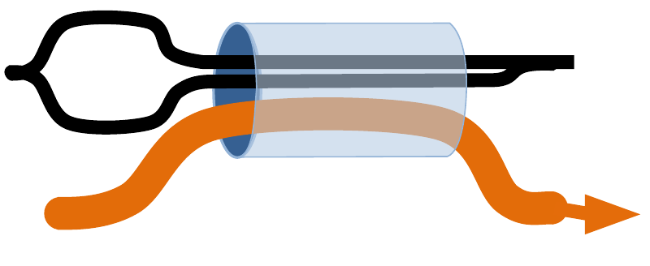
Fairness at shared bottlenecks
To be fair, MPTCP should take as much capacity as TCP at a bottleneck link, no matter how many subflows MPTCP is using.
A MPTCP with
two subflows
A regular TCP
Notes:
This is the very first thing that comes to mind with multipath TCP

Slide 33
Congestion control
A weighted version of TCP on each subflow
Split the traffic evenly?
Would not make very efficient use of the network

Slide 34
MPTCP should choose efficient paths
A scenario to illustrate the importance of choosing the less-congested path

Slide 35
MPTCP should choose efficient paths
Suppose that the three links each have capacity 12Mb/s.
Assume all RTTs are equal.
If each flow split traffic evenly, each flow will would get 4Mb/s
Hence each MPTCP would get 8Mb/s
8 Mb/s
8 Mb/s
8 Mb/s

Slide 36
MPTCP should choose efficient paths
The core idea is that a multipath ﬂow should shift all trafﬁc onto the least-congested path.
the two-hop paths will have higher drop probability than the one-hop paths
Use a path if that path has lower drop among available paths.
12 Mb/s
12 Mb/s
12 Mb/s

Slide 37
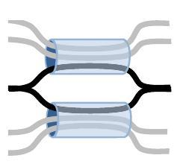
Problem of choosing path with lower data loss
There are two single-path TCPs on each link, and one multipath TCP able to use both links
Choosing path with lower data loss should end up balancing evenly across the two links

Slide 38
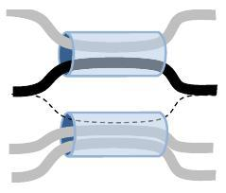
Problem of choosing path with lower data loss
Suppose now that one of the flows on the top link terminates, so the top link is less congested
The multipath TCP flow moves all traffic onto the top link

Slide 39
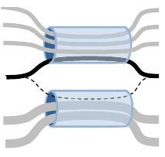
Problem of choosing path with lower data loss
No matter how much extra congestion there is on the top link, the multipath TCP flow is not using the bottom link
MPTCP gets no ACKs on the bottom link
Unable to increase the window size on the bottom subflow

Slide 40
Problems with RTT mismatch
3G path:
low loss, high RTT
Wifi path:
high loss, low RTT
Notes:
Design Goal 2 says to send all your traffic on the least congested path, in this case 3G. But this has high RTT, hence it will give low throughput.

Slide 41
Summary
MPTCP connection
initiating a MPTCP connection
adding new subflow
closing MPTCP connection
MPTCP data sequence number
multi sequence number
Congestion control
regular TCP congestion control
choosing path with lower data loss
RTT mismatching

Slide 42
Resources
Internet-Draft
TCP Extensions for Multipath Operation with Multiple Addresses, Oct 2012
Coupled Congestion Control for Multipath Transport Protocols, July 2011
Paper
C. Raiciu, et al. Improving Datacenter Performance and Robustness with MPTCP. SIGCOMM '11, August 2011.
M. Al-Fares, et al. A Scalable, Commodity Data Center Network Architecture. SIGCOMM '08, October 2008.
Presentation
http://nrg.cs.ucl.ac.uk/mptcp/
Video
Multipath TCP: http://www.youtube.com/watch?v=02nBaaIoFWU

