Slide 1
Stream Control Transmission Protocol (SCTP)
CISC 856 TCP/IP and Upper Layer Protocols
Wei Chen
Nov. 15th,2012
Thanks to:
Prof. Paul Amer
Naveen Kumar, Aparna Kailasam

Slide 2
In summary: TCP vs SCTP
Head-of-Line blocking
Strict ordering of data
Doesn’t preserve boundaries
Limited scope of TCP sockets
Vulnerable to SYN attacks
incarnation
Multi streaming
Unordered data
Message framing
Multi homing
Connection oriented
Immune to denial of service attacks and incarnation
Immune to incarnation

Slide 3
Content
Introduction
Services supported
Packet format
Association establishment, termination and abortion
Flow control, Error control and congestion control

Slide 4
Introduction
UDP
Pro: Message-oriented
Con: Unreliable
TCP
Pro: Reliable with flow, congestion control
Con: Byte-oriented
SCTP
Combines the best features of UDP and TCP

Slide 5
Content
Introduction
Services supported
Packet format
Association establishment, termination and abortion
Flow control, error control and congestion control

Slide 6
SCTP supported services
Process to process communication
Full-duplex communication
Connection-oriented service
Reliable service
Multiple streams (new)
Multihoming (new)

Slide 7
TCP single stream experiences HOL blocking
sent from application
Head Of Line blocking!
delivered to application
objects in send buffer
receive buffer
retransmission
loss
TCP connection
Web client
Web server

Slide 8
SCTP Multistreaming reduces HOL blocking
sent from application
delivered to application
objects in send buffer
receive buffer
retransmission
loss
stream 1
stream 2
stream 3
SCTP association
Web server
Web client

Slide 9
SCTP: Association
An association in SCTP is analogous to connection in TCP
An SCTP association can be represented as a pair of SCTP endpoints:
association = { [128.33.6.12, 198.3.69.5: 6590], [123.45.17.9, 19.234.45.5, 42.45.78.12: 80] }
Host A
Host B

Slide 10
multihoming Example
single-homed SCTP endpoint
multi-homed SCTP endpoint
Host A
Host B
application
application
IP1=160.15.82.20
IP2=161.10.8.221
IP3=10.1.61.11
100
200
SCTP
SCTP
A1
B1
B2
B3
IP=128.33.6.12
endpoint=[128.33.6.12 : 100]
endpoint=[160.15.82.20, 161.10.8.221, 10.1.61.11 : 200]
Host A
SCTP association
Host B
application
application
100
200
IP1=160.15.82.20
IP2=161.10.8.221
IP3=10.1.61.11
SCTP
SCTP
A1
B1
B2
B3
IP=128.33.6.12
association={ [128.33.6.12 : 100] : [160.15.82.20, 161.10.8.221, 10.1.61.11 : 200] }

Slide 11
failure detection
Host A monitors reachability of primary dest address of Host B
Host A
Host B
application
application
100
primary
200
alternates
SCTP
SCTP
A1
B1
B2
B3
DATA
SACK
Host A starts the retransmission timer
If timer expires
increment error_count
If error_count > threshold
state = inactive
If Host A receives SACK before timer expires
error_count = 0 & state = active
error_count - variable associated with each destination address of a host. (initially zero)

Slide 12
Host A monitors reachability of alternate dest addresses of Host B
Host A
Host B
application
application
100
primary
200
alternates
SCTP
SCTP
A1
B1
B2
B3
HEARTBEAT
HEARTBEAT-ACK
HEARTBEAT is sent periodically to each alternate address
When a HEARTBEAT is sent
increment error_count
If error_count > threshold
state = inactive
If Host A receives a HEARTBEAT-ACK
error_count = 0 & state = active
When primary dest address is detected unreachable =>
SCTP sender chooses REACHABLE, alternate dest address as primary

Slide 13
Content
Introduction
Services supported
SCTP packet format
Association establishment, termination and abortion
Flow control, Error control and congestion control

Slide 14
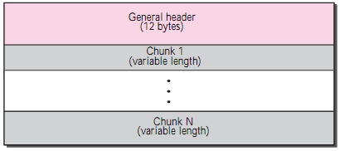
SCTP packet format
mandatory general header.
a set of blocks called chunks.
two types of chunks: control chunks and data chunks.
a control chunk controls and maintains the association
a data chunk carries user data.
Control chunks come before data chunks.

Slide 15
General Header
Verification tag
unique identifier for the association.
a separate verification used for each direction.
benefit? pkts from a previous association.
Checksum
32 bits.
allow the use of the CRC-32 checksum.

Slide 16
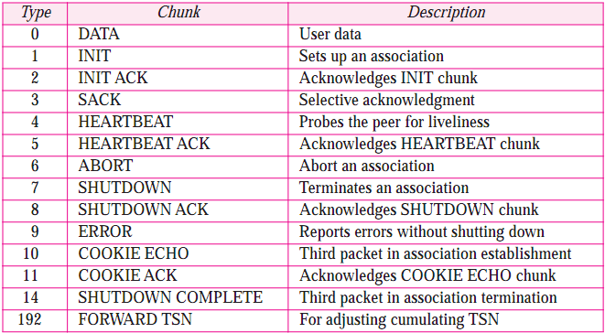
Chunks
32-bit (4-byte) boundary
Length in bytes. Including all fields but not padding.

Slide 17
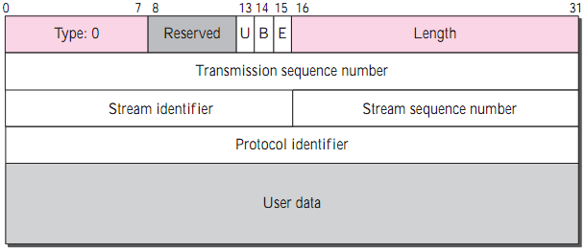
Data chunk
U: unordered. B: beginning. E: end.
Transmission Sequence Number (TSN)
Byte? No, data chunk.
Number data chunks using TSN.
Control chunk does not consume TSN.
Stream Identifier (SI)
Each stream needs to be identified.
Stream Sequence Number (SSN)
Each data chunk belong to same SI needs to be distinguished.
User data(framing, >=17, 32-bit)

Slide 18
Packet, data chunks, and streams.
11 msgs from A to B
One msg fits into one data chunk
One packet contains 3 data chunks
TSN is cumulative number for flow control and error control
SI defines the stream to which the chunk belongs.
SSN defines the chunk’s order in a particular stream

Slide 19
TCP segment vs SCTP packet
control info in control chunk, not header.
multiple data chunks for different stream.
no option, handled by defining types.
fixed length(12 bytes).
TSN, SI and SSN belong only to data chunks.
ACK number, wind size are part of each ctrl chunk.
No need for a header length field.
No need for urgent pointer.

Slide 20
Content
Introduction
Services supported
SCTP packet format
Association establishment, termination and abortion
Flow control, Error control and congestion control

Slide 21
First - TCP Connection Establishment
A
B
closed
t=0
SYN
listen
SYN sent
1RTT
SYN-ACK
SYN recd
(TCB created)
ACK
established
data
established

Slide 22
SCTP: Four-way Association setup
INIT
no TCB
INIT–ACK (stateCookie)
COOKIE–ECHO (stateCookie)
create TCB
COOKIE–ACK
DATA

Slide 23
Security: TCP Flooding Attack
process
SYN
(attackers)
(victim)
TCP-based web server
Internet
spoofed SYNs
128.3.4.5
SYN
130.2.4.15
TCB
SYN
130.2.4.15
TCB
192.10.2.8
SYN
228.3.14.5
SYN
228.3.14.5
TCB
221.3.5.10
SYN
190.13.4.1
SYN
190.13.4.1
flooded!!
TCB = Transport Control Block

Slide 24
4-way handshake limits attack
process
INIT
(attackers)
(victim)
SCTP-based web server
spoofed INITs
128.3.4.5
INIT
130.2.4.15
INIT-ACK
130.2.4.15
192.10.2.8
INIT
228.3.14.5
Internet
INIT-ACK
228.3.14.5
221.3.5.10
INIT
190.13.4.1
INIT-ACK
190.13.4.1
No reserved resources

Slide 25
Cookie
motivation
To prevent SYN flooding attack in TCP.
SCTP postpone the allocation of resources until the reception of the third packet, when the IP address of the sender is verified.
The information received in the first packet must somehow be saved until the third packet arrives.
But if the server saves the information, that would require the allocation of resources.
how does it work
Generating a cookie.
Processing a cookie. If an attacker, cookie lost; if an real one, sends cookie back without changes. Then server allocates resource.
Make sure the cookie is not changed? Server makes the cookie by encoding the protected info with its own secret key.
When the cookie is returned in the third packet, the server decode the cookie to make sure it is correct.

Slide 26
SCTP Association setup
Host A
Host B
V: verification tag
I: initiation tag
R: rwnd
IT: Init TSN
closed
INIT (V=0; I=1200)
(R: 1000;IT:100)
cookie
wait
closed
(0, 2³² − 1)
INIT PDU

Slide 27
SCTP Association setup (cont’d)
Host A
Host B
V: verification tag
I: initiation tag
R: rwnd
IT: Init TSN
closed
INIT (V=0; I=1200)
(R: 1000;IT:100)
cookie
wait
closed
INIT_ACK (V=1200)
(I=5000;R=2000; IT=1700)
INIT ACK PDU

Slide 28
SCTP Association setup (cont’d)
Host A
Host B
V: verification tag
I: initiation tag
R: rwnd
IT: Init TSN
closed
INIT (V=0; I=1200)
(R: 1000;IT:100)
cookie
wait
closed
INIT_ACK (V=1200)
(I=5000;R=2000; IT=1700)
cookie
echoed
COOKIE_ECHO (V=5000)
COOKIE ECHO PDU

Slide 29
SCTP Association setup (cont’d)
Host A
Host B
V: verification tag
I: initiation tag
R: rwnd
IT: Init TSN
closed
INIT (V=0; I=1200)
(R: 1000;IT:100)
cookie
wait
closed
INIT_ACK (V=1200)
(I=5000;R=2000; IT=1700)
cookie
echoed
COOKIE_ECHO (V=5000)
COOKIE_ACK (V=1200)
estbl’d
estbl’d
4–way handshake !
COOKIE ACK PDU

Slide 30
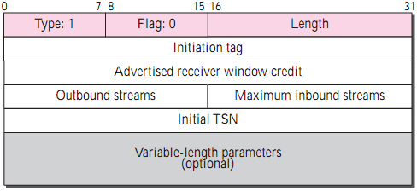
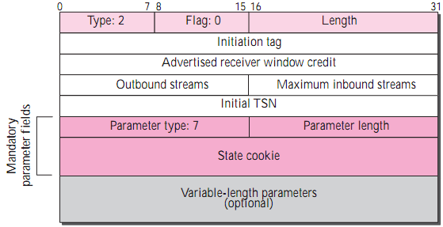
INIT chunk
1.Initiation tag: (0, 2³² − 1).
2.Outbound stream: suggested number of outgoing streams.
3.Maximum inbound stream: maximum allowed number of incoming streams.
No other chunk can be carried in a packet that carries an INIT or INIT ACK chunk.
INIT ACK chunk
1.State cookie. Talk this later.

Slide 31
Data transfer
TCP
Treat messages from app as a stream of bytes without recognizing any boundary.
A segment can carry parts of several different messages.
SCTP
Each message from app is inserted into a single DATA chunk unless it is fragmented.
Only data chunks consume TSNs. Data chunks are the only chunks that are ACKed.

Slide 32
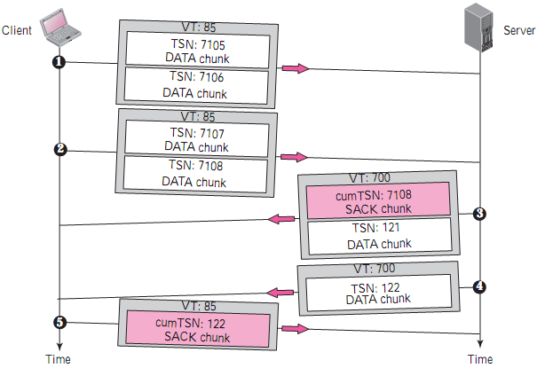
Simple example for data transfer
a client sends four DATA chunks and receives two DATA chunks from the server.
SCTP acks the last in-order TSN, not the next expected.
Fragmentation? Multistream Delivery?
Notes:
Client sends the first packet carrying two data chunks with TSNs …
2. Client sends the second packet carrying two data chunks with TSNs…
3. The third packet is from the server. It contains SACK chunk and data chunk. SACK chunk is used to ack the receipt of DATA chunks from the client. Contrary to TCP, SCTP acknowledges the last in-order TSN received, not the next expected.
4. After a while, server sends another packet does not include a SACK chunk in the packet because the last DATA chunk received was already acknowledged.
5.finally, the client sends back a packet contains only a SACK chunk.

Slide 33
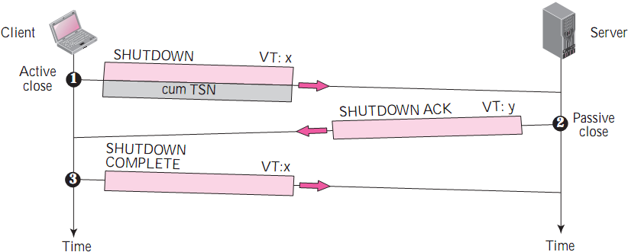
Association termination and abortion

Slide 34
In summary: TCP vs SCTP
Head-of-Line blocking
Strict ordering of data
Doesn’t preserve boundaries
Limited scope of TCP sockets
Vulnerable to SYN attacks
incarnation
Multi streaming
Unordered data
Message framing
Multi homing
Connection oriented
Immune to denial of service attacks and incarnation
Immune to incarnation

Slide 35
Thanks!

Slide 36
Content
Introduction
Services supported
SCTP packet format
Association establishment, termination and abortion
Flow control, Error control and congestion control

Slide 37
Flow control-receiver site
cumTSN: Last TSN received.
winsize.: available buffer size.
lastACK: the last accumulative acknowledgment.
When the receiver receives a data chunk,
Stores data, update cumTSN and winSize.
When above process reads a data chunk,
Remove it from queue, update winSize.
When the receiver decides to send a SACK,
Checks the lastACK, if less than cumTSN, sends a SACK with cummulcative TSN equal to cumTSN, including value of rwnd as, value of winSize, and then update lastACK.
Notes:
In TCP, we need to deal with only one unit of data, the byte. In SCTP, we need to handle two units of data, the byte and the chunk.
The values of rwnd and cwnd are expressed in bytes; the values of TSN and acknowledgments are expressed in chunks.

Slide 38
Flow control-sender site
cumTSN: the next chunk to be sent.
rwnd.: the last value advertised by the receiver (in bytes).
inTransit: the number of bytes in transit, bytes sent but not yet acknowledged..
A chunk pointed to by curTSN can be sent if the size of the data is less than or equal to the quantity (rwnd − inTransit).
After sending a chunk, update curTSN by 1, update inTransit by bytes.
When a SACK received, the chunks with a TSN less than or equal to the cumulative TSN in the SACK are removed and discarded. The value of inTransit is reduced by total bytes; the value of rwnd is updated by the value of the advertised window in the SACK.

Slide 39
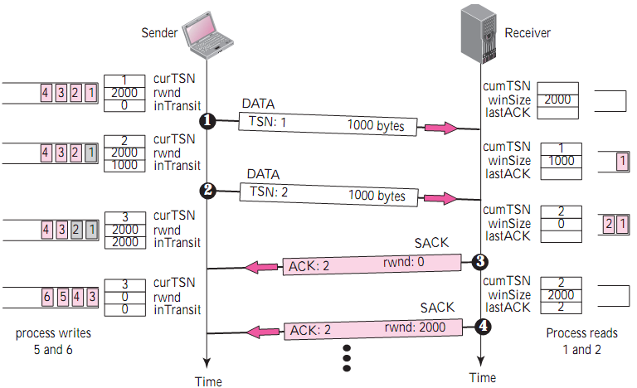
Example for flow control

Slide 40
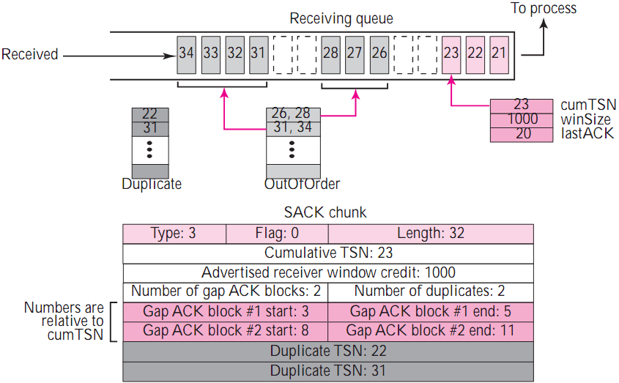
Error control-receiver site
Leave space for missing chunks; discards duplicate messages but keep track of them for reports to the sender

Slide 41
Error control-sender site
Notes:
two buffers (queues): a sending queue and a retransmission queue.

Slide 42
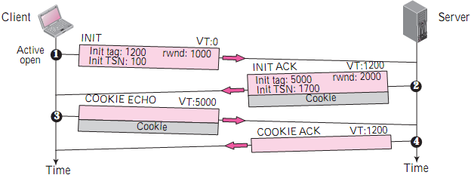
Association Establishment
Four-way handshaking
INIT: VT = 0; Init tag= 1200; Init TSN = 100; rwnd = 1000.
INIT ACK: cookie defines the state of the server.
COOKIE ECHO: without change, the cookie sent back.
No other chunk is allowed in a packet carrying an INIT or INIT ACK chunk. Packet carrying A COOKIE ECHO or a COOKIE ACK chunk can carry data chunks.
Notes:
COOKIE ECHO chunk can carry user data.

Slide 43
