Slide 1
Transport Layer Security (TLS)
Bo Lu
CISC856
10/23/2012
Thank Vivek Nelamangala for his slides

Slide 2
Outline
Motivation
Security services
Cryptographic techniques
TLS protocol in detail
Summary

Slide 3
Motivation
Internet nowadays is fast but not safe
Denial of service
Sniffing
Source masquerading
Message modification and deletion

Slide 4
Motivation
Security is vital for certain applications
Electronic commerce
Electronic mail
And many more

Slide 5
Motivation
TCP/IP suite itself does not provide secure communication
Security can be done in different layers
Network layer: IPSec (IP security) and IKE (Internet key exchange)
Transport layer: SSL/TLS (main topic today)
Application layer: PGP (Pretty good privacy)

Slide 6
Security services
Confidentiality
Only communicating parties can interpret the content

Slide 7
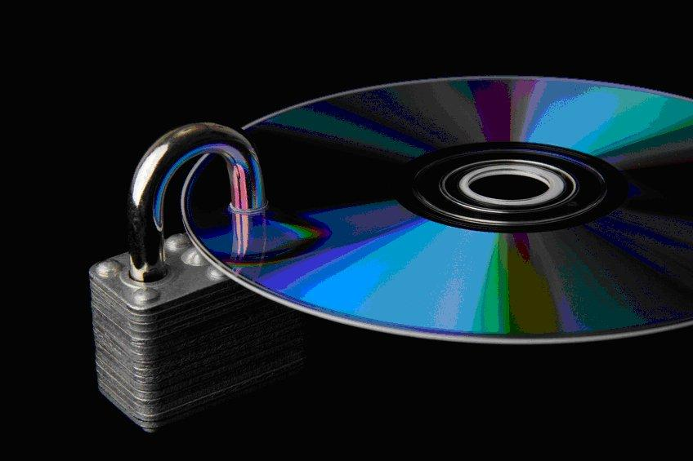
Security services
Data Integrity
Data are protected from unauthorized modification

Slide 8
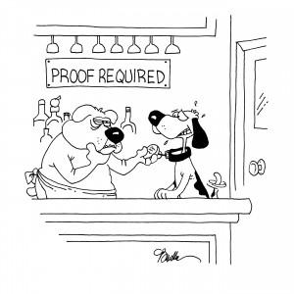
Security services
End-point authentication
Communicating parties are able to verify each other's identity

Slide 9
Cryptographic Techniques
Symmetric encription
A secret key is shared between the participating entities
Provide confidentiality
Sender
Receiver
Ciphertext = Encryption (Shared key, Plaintext)
Plaintext = Decryption (Shared key, Ciphertext )
Ciphertext

Slide 10
Cryptographic Techniques
Public key encryption
One public key and one secret key which is not shared
Provide confidentiality and end-point authentication
Sender
Receiver
Ciphertext = Encryption (Public key of receiver, Plaintext)
Ciphertext
Plaintext = Decryption (Secret key of receiver, Ciphertext)

Slide 11
Cryptographic Techniques
Hash function
Output has a constant size
Different input gives different output
Provide data integrity
Sender
Receiver
Hash(Text + Authentication key)
Text, Hash
Hash(Text + Authentication key)

Slide 12
What is TLS?
Protocol layer below application layer
Works on top of reliable transport layer protocol such as TCP
Supports any application protocols
Application Layer
TLS Alert Protocol
TLS Change Cipher Spec
TLS Handshake Protocol
TLS Data Protocol
TLS Record Protocol
TCP
IP

Slide 13
TLS Handshake protocol
The core protocol of TLS
Authentication
Cipher suite negotiation
Compression method negotiation

Slide 14
TLS Alert protocol and TLS Change cipher spec protocol
Alert protocol
Signal indicators of potential problems and exchange corresponding alert messages.
Change cipher spec protocol
Put cipher spec parameters in place and make them effective

Slide 15
TLS Application data protocol
Takes higher-layer data and feeds it into the TLS record protocol for cryptographic protection and secure transmission

Slide 16
TLS record protocol
Securely transmit higher-layer protocol data from the sender to the recipient.

Slide 17
Confidentiality in TLS
Cipher
Use symmetric encryption
DES (Data encryption standard), 3DES
RC (Ron's code)
IDEA (International Data Encryption Algorithm)
Key exchange
Need secure method to exchange the shared secret key(master secrete)
Use public key encryption
RSA, Diffie-Hellman

Slide 18
Data Integrity in TLS
Each TLS record PDU is affixed with a message authentication code (MAC)
Hash of the message – MD5 and SHA1
Shared secret key(generated from master secret)
Sequence number (TLS record PDU)

Slide 19
End-point authentication in TLS
Based on public key certificates
Uses X.509 protocol for certificate management
Client authentication is optional

Slide 20
TLS connection establishment
TLS Handshake
Negotiate cipher suite
Symmetric cipher
Key exchange method
Hash function
Negotiate a compression method
Establish and share master secret
Optionally authenticate server and/or client

Slide 21
TLS connection establishment
Handshake phases
Hello messages
Certificate and Key exchange messages
Change CipherSpec and Finished messages

Slide 22
TLS connection establishment
TLS: Hello
Client Hello initiates sesion
Propose protocol version
Propose cipher suite
Server Hello chooses protocol version and suite and an session identifier if session resumption is permitted
Client may request to resume a TLS session
Server chooses whether to accept request
Both client and server needs to generate a random number which is used in generating master secrete

Slide 23
TLS connection establishment
Public Key Certificates
X.509 Certificate associates public key with identity
Certification Authority (CA) creates certificate
Must recognize accepted CA in certificate chain
One CA may issue certificate for another CA

Slide 24
TLS connection establishment
TLS: Key exchange
Server sends certificate containing public key (RSA) or Diffie-Hellman parameters
Client sends encrypted “pre-master” secret to server using Client Key Exchange message
Master secret calculated
Use random values passed in Client and Server Hello messages

Slide 25
TLS connection establishment
TLS: Change Cipher Spec/Finished
Change Cipher Spec
Announce switch to negotiated algorithms and values
Finished
Send copy of handshake
Permits validation of handshake
The first message that is encrypted with the cipher spec

Slide 26
TLS connection establishment
Time
Client
Server
client hello
server hello
certificate
server_key_exchange
certificate_request
server_hello_done
certificate
client_key_exchange
certificate_verify
change_cipher_spec
finished
change_cipher_spec
finished

Slide 27
TLS session resumption
Time
Client
Server
client hello
server hello
change_cipher_spec
finished
change_cipher_spec
finished

Slide 28
Application data transmission using TLS
Application
Fragment
Compress
Add MAC
Encrypt TLS record SDU
Add PCI TLS record PDU
A-PDU
16384 or less
16384 or less
16384 or less

Slide 29
TLS session and connection
TLS connection
Used for actual cryptographically protected data transmission
TLS session
Association between two communication parties created using the TLS handshake protocol. Can be broken and resumed and shared among multiple TLS connections.

Slide 30
Summary
TLS addresses the need for security in transport layer
Confidentiality: Symmetric encryption with a shared secret key
Data integrity: Message authentication codes
End to end authentication: x.509 certificates
Any application that uses TCP can rely on TLS

Slide 31
Any questions?
Thanks for your attention :)

