Slide 1
The Voice Over Internet Protocol(VOIP)/ RTP/ RTSP
Presented by: Yuvraj Khadke
CISC 856: TCP/IP and Upper Layer Protocols
11/29/2012
Credits to: Christopher Thorpe, Varsha Mahadevan, Kevin Jeffay, James F. Kurose, Keith W. Ross

Slide 2
Reasons for VOIP’s growth
Demand for multimedia communication.
Demand for integration of voice and data networks.
Demand for greater flexibility.
Cost reduction in long distance telephone calls.

Slide 3
Voice-over-IP (VoIP)
VoIP end-end-delay requirement: needed to maintain “conversational” aspect
higher delays noticeable, impair interactivity
< 150 msec: good
> 400 msec bad
includes application-level (packetization,playout), network delays
value-added services: call forwarding, screening, recording

Slide 4
VoIP characteristics
speaker’s audio: alternating talk spurts, silent periods.
64 kbps during talk spurt
pkts generated only during talk spurts
20 msec chunks at 8 Kbytes/sec: 160 bytes of data
application-layer header added to each VOIP PDU
VOIP PDU+header encapsulated into UDP or TCP SDU
application sends VOIP PDU into socket every 20 msec during talkspurt

Slide 5
VoIP: PDU loss, delay
network loss: IP PDU lost due to network congestion (router buffer overflow)
delay loss: IP PDU arrives too late for playout at receiver
delays: processing, queueing in network; end-system (sender, receiver) delays
typical maximum tolerable delay: 400 ms
loss tolerance: depending on voice encoding, loss concealment, PDU loss rates between 1% and 10% can be tolerated

Slide 6
Delay jitter
constant bit
rate
transmission
client
reception
constant bit
rate playout
at client
Cumulative data
variable
network
delay
(jitter)
buffered
data
client playout
delay
time
end-to-end delays of two consecutive PDU’s: difference can be more or less than 20 msec (transmission time difference)

Slide 7
VoIP: fixed playout delay
receiver attempts to playout each VOIP PDU exactly q msecs after chunk was generated.
VOIP PDU has time stamp t: play out chunk at t+q
VOIP PDUarrives after t+q: data arrives too late for playout: data “lost”

Slide 8
VoIP: fixed playout delay
sender generates PDU’s every 20 msec during talk spurt.
first PDU received at time r
first playout schedule: begins at p
second playout schedule: begins at p’

Slide 9
Adaptive playout delay (1)
goal: low playout delay and low late loss rate
approach: adaptive playout delay adjustment:
estimate network delay, adjust playout delay at beginning of each talk spurt
d_{i} = (1−α)d_{i-1} + α (r_{i} – t_{i})
delay estimate after ith PDU
small constant, e.g. 0.1
time received -
time sent (timestamp)
measured delay of ith PDU

Slide 10
Adaptive playout delay (2)
if no loss, receiver looks at successive timestamps
difference of successive stamps > 20 msec -->talk spurt begins.
with loss possible, receiver must look at both time stamps and sequence numbers
difference of successive stamps > 20 msec and sequence numbers without gaps --> talk spurt begins.

Slide 11
VoiP: recovery from PDU loss (1)
Challenge: recover from PDU loss given small tolerable delay between original transmission and playout
each ACK/NAK takes ~ one RTT
alternative: Forward Error Correction (FEC)
send enough bits to allow recovery without retransmission
simple FEC
for every group of n PDU’s , create redundant PDU by exclusive OR-ing n original PDU’s
send n+1 PDU’s, increasing bandwidth by factor 1/n
can reconstruct original n PDU’s if at most one lost chunk from n+1 PDU’s, with playout delay

Slide 12
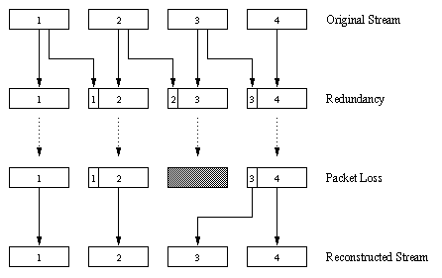
VoiP: recovery from PDU loss (2)
another FEC scheme:
“piggyback lower quality stream”
send lower resolution audio stream as redundant information
non-consecutive loss: receiver can conceal loss
generalization: can also append (n-1)st and (n-2)nd low-bit rate chunk

Slide 13
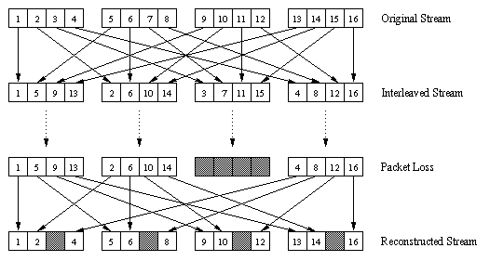
VoiP: recovery from PDU loss (3)
interleaving to conceal loss:
audio VOIP PDU’s divided into smaller units, e.g. four 5 msec units per 20 msec audio VOIP PDU
PDU contains small units from different VOIP PDU’s
if PDU lost, still have most of every original VOIP PDU
no redundancy overhead, but increases playout delay

Slide 14
Real-Time Protocol (RTP)
RTP specifies PDU structure for PDU’s carrying audio, video data
RTP PDU provides
payload type identification
PDU sequence numbering
time stamping
RTP PDU’s encapsulated in UDP SDU
interoperability: if two VoIP applications run RTP, they may be able to work together

Slide 15
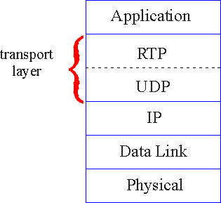
RTP runs on top of UDP
RTP libraries provide transport-layer interface
that extends UDP:
port numbers, IP addresses
payload type identification
PDU sequence numbering
time-stamping

Slide 16
RTP example
example: sending 64 kbps PCM-encoded voice over RTP
application collects encoded data in VOIP PDU’s, e.g., every 20 msec = 160 bytes in a chunk
audio VOIP PDU’s + RTP header form RTP PDU, which is encapsulated in UDP SDU
RTP header indicates type of audio encoding in each PDU
sender can change encoding during conference
RTP header also contains sequence numbers, timestamps

Slide 17
RTP and QoS
RTP does not provide any mechanism to ensure timely data delivery or other QoS guarantees
RTP encapsulation only seen at end systems (not by intermediate routers)
routers provide best-effort service, making no special effort to ensure that RTP PDU’s arrive at destination in timely matter

Slide 18
RTP header
payload type
sequence number type
time stamp
Synchronization
Source ID
Miscellaneous fields
payload type (7 bits): indicates type of encoding currently being used. If sender changes encoding during call, sender
informs receiver via payload type field
Payload type 0: PCM mu-law, 64 kbps
Payload type 3: GSM, 13 kbps
Payload type 7: LPC, 2.4 kbps
Payload type 26: Motion JPEG
Payload type 31: H.261
Payload type 33: MPEG2 video
sequence # (16 bits): increment by one for each RTP PDU sent
detect PDU loss, restore PDU sequence

Slide 19
RTP header
payload type
sequence number type
time stamp
Synchronization
Source ID
Miscellaneous fields
timestamp field (32 bits long): sampling instant of first byte in this RTP data PDU
for audio, timestamp clock increments by one for each sampling period (e.g., each 125 usecs for 8 KHz sampling clock)
SSRC field (32 bits long): identifies source of RTP stream. Each stream in RTP session has distinct SSRC

Slide 20
Real-Time Control Protocol (RTCP)
works in conjunction with RTP
each participant in RTP session periodically sends RTCP control PDU’s to all other participants
each RTCP PDU contains sender and/or receiver reports
report statistics useful to application: # PDU’s sent, # PDU’s lost, interarrival jitter
feedback used to control performance
sender may modify its transmissions based on feedback

Slide 21
RTCP: multiple multicast senders
sender
RTP
RTCP
RTCP
RTCP
receivers
each RTP session: typically a single multicast address; all RTP /RTCP PDU’s belonging to session use multicast address
RTP, RTCP PDU’s distinguished from each other via distinct port numbers
to limit traffic, each participant reduces RTCP traffic as number of conference participants increases

Slide 22
RTCP: PDU types
receiver report PDU’s:
fraction of PDU’s lost, last sequence number, average interarrival jitter
sender report PDU’s:
SSRC of RTP stream, current time, number of PDU’s sent, number of bytes sent
source description PDU’s:
e-mail address of sender, sender's name, SSRC of associated RTP stream
provide mapping between the SSRC and the user/host name

Slide 23
RTCP: stream synchronization
RTCP can synchronize different media streams within a RTP session
timestamps in RTP PDU’s tied to the video, audio sampling clocks
each RTCP sender-report PDU contains (for most recently generated PDU in associated RTP stream):
timestamp of RTP PDU
receivers uses association to synchronize playout of audio, video

Slide 24
RTCP: bandwidth scaling
RTCP attempts to limit its traffic to 5% of session bandwidth
example : one sender, sending video at 2 Mbps
RTCP attempts to limit RTCP traffic to 100 Kbps
RTCP gives 75% of rate to receivers; remaining 25% to sender
75 kbps is equally shared among receivers:
with R receivers, each receiver gets to send RTCP traffic at 75/R kbps.
sender gets to send RTCP traffic at 25 kbps.
participant determines RTCP PDU transmission period by calculating avg RTCP PDU size and dividing by allocated rate

Slide 25
Thank You…

Slide 26
Voice-over-IP: Skype
Skype clients (SC)
P2P components:
Skype
login server
supernode (SN)
clients: skype peers connect directly to each other for VoIP call
supernode
overlay
network
super nodes (SN): skype peers with special functions
overlay network: among SNs to locate SCs
login server

Slide 27
P2P voice-over-IP: skype
skype client operation:
1. joins skype network by contacting SN (IP address cached) using TCP
Skype
login server
2. logs-in (usename, password) to centralized skype login server
3. obtains IP address for callee from SN, SN overlay
or client buddy list
4. initiate call directly to callee

Slide 28
Skype: peers as relays
problem: both Alice, Bob are behind “NATs”
NAT prevents outside peer from initiating connection to insider peer
inside peer can initiate connection to outside
relay solution: Alice, Bob maintain open connection
to their SNs
Alice signals her SN to connect to Bob
Alice’s SN connects to Bob’s SN
Bob’s SN connects to Bob over open connection Bob initially initiated to his SN

Slide 29
VOIP using Skype Login
Start
Wait for 6 seconds
No
Send UDP PDUs to HC IP addresses and ports
Connection attempts == 5?
Failure
Yes
Response within 5 seconds
Yes
No
Connected ?
Yes
No
TCP connection attempt with HC IP address and port
TCP connection attempt with HC IP address and port 443 (HTTPS port)
Connected ?
Yes
Success
No
Connected ?
Yes
No
TCP connection attempt with HC IP address and port 80

Slide 30
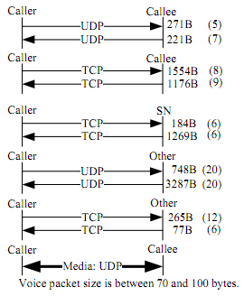
Skype Call Establishment
Call Establishment without NAT
Call Establishment with NAT
Skype uses Jabber protocol to connect with chat servers

Slide 31
Skype Call Maintenance and Teardown
Skype call “keep alive” process
Skype call teardown

